Slide 1
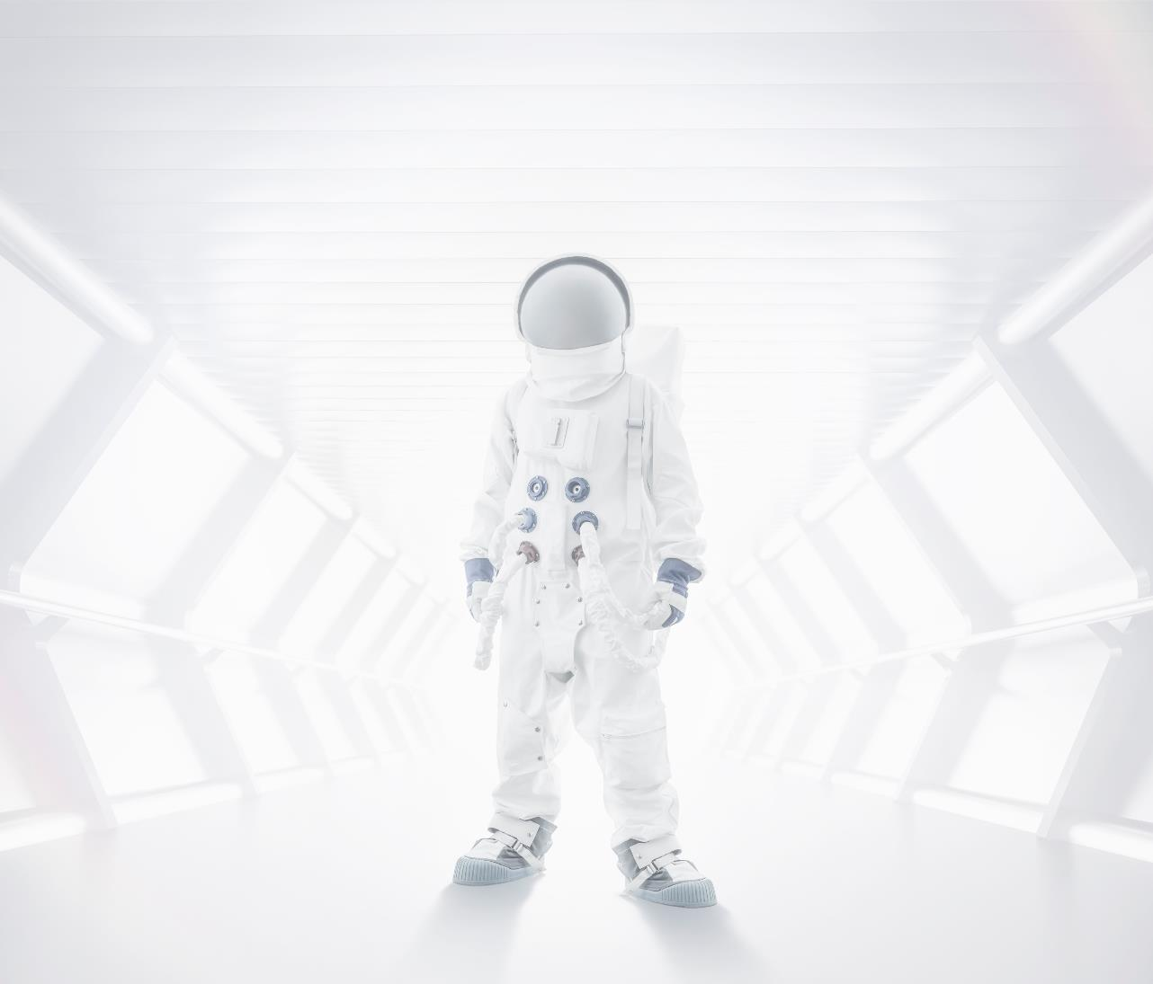
Perpetual Motion Squad
NASA SPACE APPS CHALLENGE
Dinakaran
Thiwakar B
Swapnanil Goswami
Andrew Ryolen Lautener

Slide 2

Name of the app is:
SENGA

Slide 3

Summary
Sleep shift Monitoring Tool
Provides sleep reminders accordingly by detecting an individual’s sleep activity and body type
The daily schedule of crew members involving activities like Launching, Docking, Loading, Unloading, Sleep shift can be monitored and adjusted.
Also short naps, meal timing, exercise time, nutrition can be monitored and activities can be adjusted acoordingly.
The application can be used by crew members in space and on Earths surface.
Uses GPS data to monitor location and also RF in space.

Slide 4
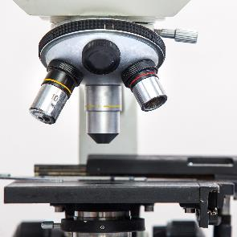

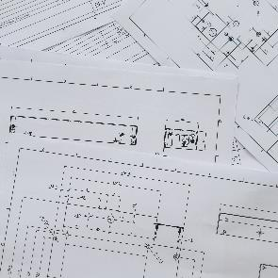
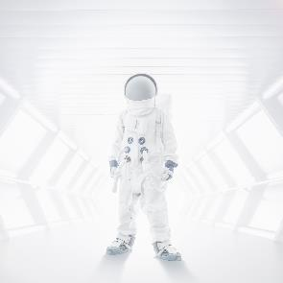


Hypothesis
Concept of multiple layer app design used.
Data is taken from various sensing like brain impulse, proximity, GPS, RF etc
Taking into considerations the melatonin levels of a member the blue light adjustment can be done.
1
2
3
4
5
6

Slide 5
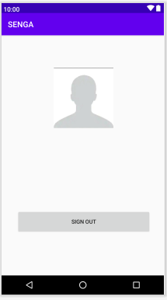
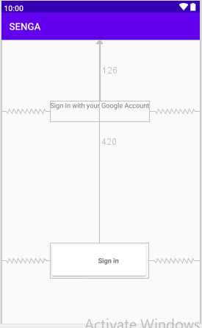
App Functionalities

Slide 6
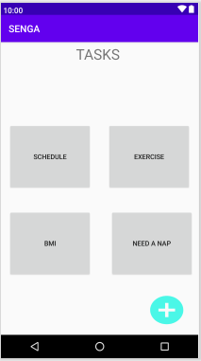

Slide 7
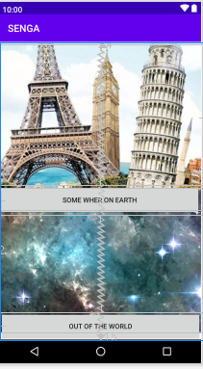

Slide 8

Thank You

